Slide 1
Refugee Resettlement Program
Immigration Law 250
February 26, 2025
Carmella Iacovetta

Slide 2
Executive Order 14163
Revokes: EO 14013

Slide 3
What is the big deal?
Notes:
https://www.houstonpublicmedia.org/articles/news/politics/immigration/2025/02/11/513534/galveston-houston-catholic-charities-lays-off-120-employees-amidst-refugee-resettlement-program-suspension/

Slide 4
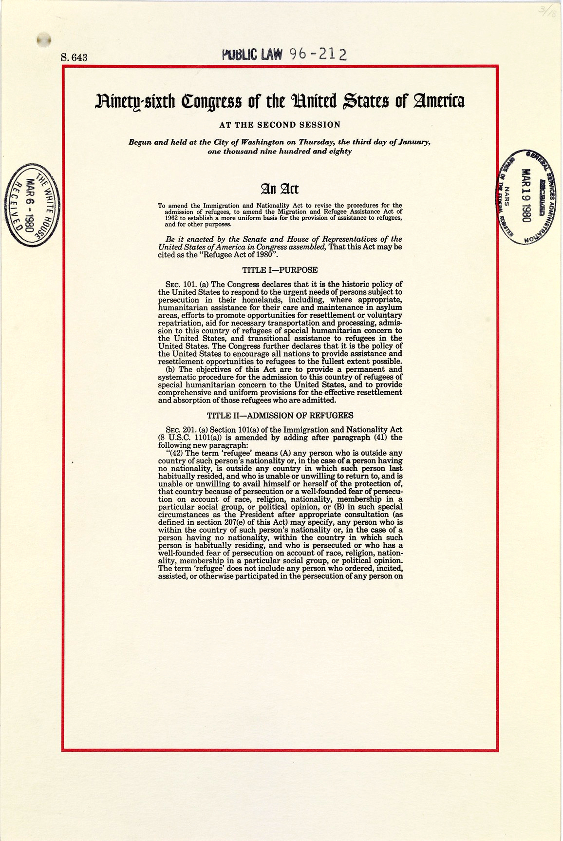
Jimmy Carter

Slide 5
The United States Refugee Admissions Program (USRAP) Consultation and Worldwide Processing Priorities
Notes:
https://www.uscis.gov/humanitarian/refugees-and-asylum/usrap

Slide 6
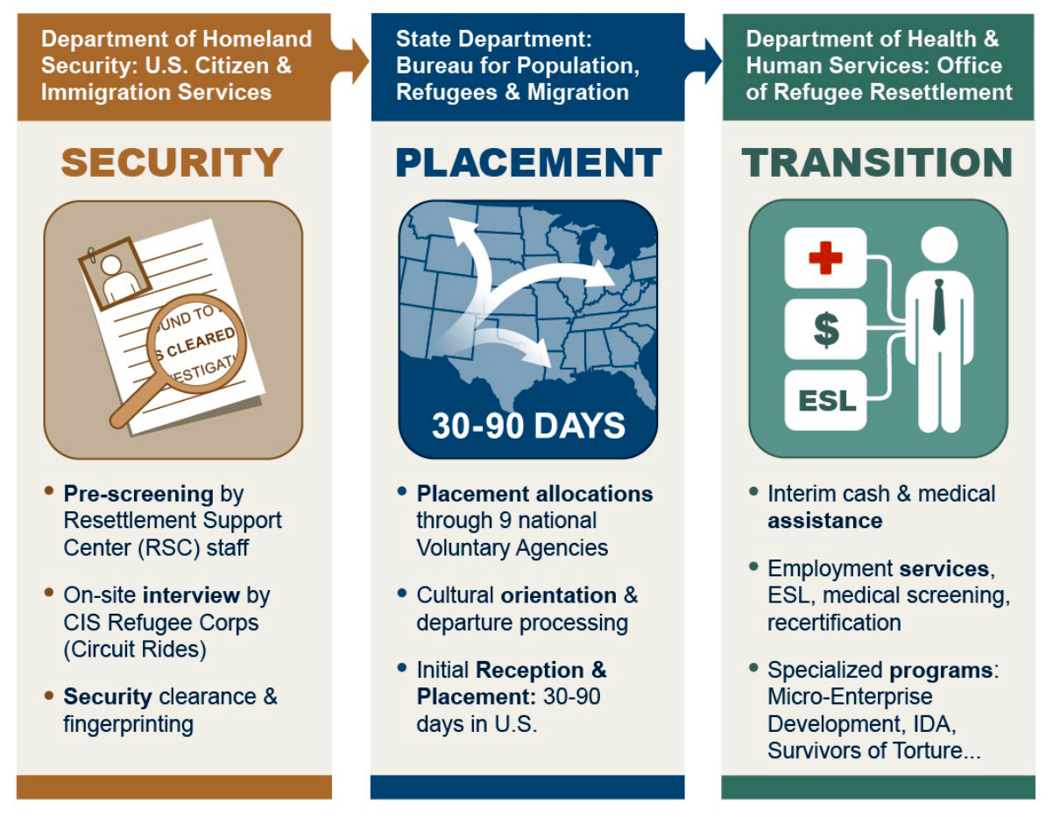
Notes:
Refugee Program Overview https://acf.gov/orr/policy-guidance/us-refugee-resettlement-program-overview

Slide 7
Documents/Codes | Comments
I-94 Arrival/departure record noting that the individual has been admitted under §207 of the INA | Notations may include references to employment authorization, indefinite status, and the requirement to obtain permission before leaving the United States
RE-1 admission code on the I-94 | Principal Refugee
RE-2 admission code on the I-94 | Spouse of principal refugee
RE-3 admission code on the I-94 | Child of principal refugee
RE-4 admission code on the I-94 | Collateral relatives of principal refugee
RE-5 admission code on the I-94 | Certain Haitian refugees
I-766 Employment Authorization Document with the code A03 | None
DHS Form I-571 | United States Refugee Travel Document⁷
I-730 Approval Letter | The I-730 Approval Letter may be used as proof of refugee status for derivatives
Visa 93 (or V-93) on the I-94 Arrival/departure card | May be accompanied by the words "section 207"; Individual is the spouse or minor child of a previously admitted refugee⁸
Acceptable documents for refugees admitted under § 207 of the INA
Notes:
https://www.acf.hhs.gov/orr/policy-guidance/status-and-documentation-requirements-orr-refugee-resettlement-program#refugees
I-730 Approval Letter: youtube https://www.youtube.com/watch?v=hzSKNPhRgT0

Slide 8
Security
Department of Homeland Security Security: U.S. Citizen & Immigration Services
Notes:
https://acf.gov/orr/policy-guidance/us-refugee-resettlement-program-overview

Slide 9
Placement
Church World Service (CWS)
Ethiopian Community Development Council (ECDC) (secular)
Episcopal Migration Ministries (EMM)
Hebrew Immigrant Aid Society (HIAS)
International Rescue Committee (IRC) (secular)
US Committee for Refugees and Immigrants (USCRI) (secular)
Lutheran Immigration and Refugee Services (LIRS)
United States Conference of Catholic Bishops (USCCB)
World Relief Corporation (WR
Bethany Christian Services
10
VOLAGS
Department of State: Bureau for Population, Refugees & Migration
Notes:
https://acf.gov/orr/policy-guidance/us-refugee-resettlement-program-overview
Volag

Slide 10
Transition
Department of Health & Human Services: Office of Refugee resettlement
Notes:
https://acf.gov/orr/policy-guidance/us-refugee-resettlement-program-overview

Slide 11
Are they public charges?

Slide 12
Citations

