Slide 1
6
Juvenile Delinquency

Slide 2
Chapter Objectives
Contrast legal, social, and psychological definitions of delinquency.
Identify the categories and extent of juvenile offending, including status and serious offending.
Describe Moffitt's developmental theory of delinquency.
Describe the dual systems model of risk taking among adolescents.

Slide 3
Chapter Objectives
Describe Patterson's coercion developmental theory.
Introduce callous-unemotional traits as features of serious delinquency.
Summarize features of effective programs for juvenile offenders.

Slide 4
Other Objectives
NVCC has an entire course on Juvenile Delinquency
This lecture will only look at the behavioral aspects of Delinquency
Some definitions will be required

Slide 5
Definitions of Delinquency
Legal definition
  Behavior against the criminal code committed by an individual who has not reached adulthood, as defined by state or federal law
    Status offenses
    Criminal courts v. juvenile courts
      Some crimes will automatically elevate to criminal court (murder)
      Generally will not certify misdemeanors

Slide 6
Definitions of Delinquency
Social definition
  A wide variety of youthful behaviors considered inappropriate
    Not all criminal
Youthful Offenders
  Generally includes young adults
    Federal system goes to 25 years old
    Not a separate court, just separate sentencing guidelines
  Not used in Virginia
    May factor in presentence report

Slide 7
Definitions of Delinquency
Psychological definitions
  Conduct disorder
  Oppositional Defiant Disorder
    Unlike conduct disorder, does not usually involve aggression, property destruction, animal cruelty, property damage or theft
  Antisocial behavior

Slide 8
Definitions of Delinquency
Age of criminal responsibility
  Not in Virginia Code

Slide 9
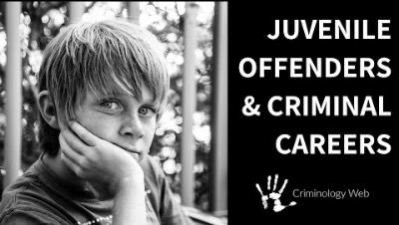
The Nature and Extent of Juvenile Offending

Slide 10

Status Offenses

Slide 11
Status Offenses
Status offenses
  Acts that only juveniles can commit
    Typically handled in juvenile or family court
  National Center for Juvenile Justice
    Running away
    Truancy
    Ungovernability

Slide 12
Status Offenses
Status offenses
    Underage liquor law violations: Is this really a status offense? Or is it a criminal violation?
    According to Code of Virginia §4.1-305(C), 16.1-278.9 and 16.1-278.8: It is illegal for anyone under 21 to possess any alcoholic beverage. Violators are guilty of a Class 1 misdemeanor and face a fine of up to $2,500 and/or a year in jail if convicted.

Slide 13
Status Offenses
Status offenses
    Similar to alcohol violations are tobacco violations, driver licensing laws that lead to unlicensed driving and fake ID’s, all criminal violations.
    If no status offender can be placed in detention, what does the court do with the habitual violator of acts that are not criminal such as truancy or running away from home?
      Alternatives to detention for the habitual status offender, ideas?

Slide 14
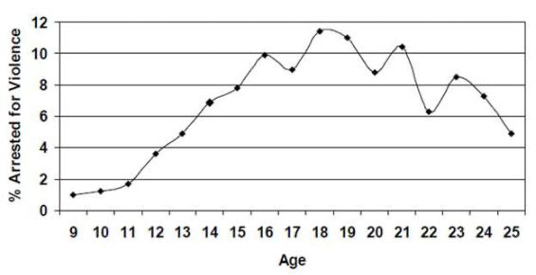
The Nature and Extent of Juvenile Offending
Violent crime trend by age: National Institute of Justice

Slide 15
The Nature and Extent of Juvenile Offending
The serious delinquent
  Often escape detection
    A lot of juvenile facilities are not secure.
      Trying to build trust
  High in recidivism
  Wide variety of offenses
  Behaviors begin at early age

Slide 16
The Nature and Extent of Juvenile Offending
Gender differences
  Boys outnumber girls in violent offending 72% vs 18%.
  Closest spread between genders is for theft 55% Males, 45% females. This is also true for adults.
  Running away and prostitution
    Prostitution is an issue for both genders
      Maybe the only way to support themselves
      Human trafficking
    History of violent victimization for girls leads them to run away

Slide 17
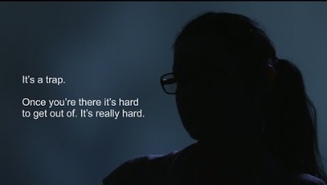
Juvenile Human Trafficking (4:29)

Slide 18
The Nature and Extent of Juvenile Offending
Gender differences
  The Girls Study Group (GSG). Risk factors for girls developing violent behaviors. Similar to boys:
    Peer violence
    Violence within schools/school quality
    Family dynamics
      Supervision
      Family criminality
    Sexual or physical abuse

Slide 19
The Nature and Extent of Juvenile Offending
Gender differences affecting girls more than boys:
    Depression
      While this affects both genders, girls are much more likely to be diagnosed with depression.
    Early puberty
      Affects girls more than boys because it leads to association with older male peers
    Romantic partners
      For serious crimes, no gender difference. Girls more affected by romantic partners for minor offenses

Slide 20
The Nature and Extent of Juvenile Offending
    Violence within disadvantaged neighborhoods
    Girls in gangs
      Girls’ roles in gangs often not violent
        Used as prostitutes to raise money
    Family violence

Slide 21
Developmental Theories of Delinquency
Moffitt's developmental theory
  Life-Course Persistent offenders (LCP)
    Lifelong antisocial behavior across many conditions
      Beginning early in life
    Neurological problems during childhood
    A small minority of children follow a high antisocial developmental trajectory.
    Most difficult to treat
      Personality disorder (after age 18)

Slide 22
Developmental Theories of Delinquency
Moffitt's developmental theory
  Adolescence-limited offenders
    The majority of juvenile offenders
    Begin offending during adolescence and stop around age 18
      This was the original theory
      Changed to include “Emerging Adulthood”
        Too many juvenile offenders did not show any criminal abatement until mid to late 20’s
        The reason for the Youthful Offender approaches to corrections

Slide 23
Developmental Theories of Delinquency
    The frequency and violence level may be as high as that of the LCP youth.
      But it is less ingrained into personality
      More amenable to treatment
        Still not a good prognosis

Slide 24
Developmental Theories of Delinquency
Developmental gender differences for delinquency
  An ongoing association with delinquent peers appears to be an important factor in the onset of delinquency among adolescent girls & boys.
  An intimate relationship with a male delinquent is also closely connected to delinquency in adolescent girls.
    Boyfriend for juvenile
    Husband for Youthful Offender

Slide 25
Developmental Theories of Delinquency
Steinberg's dual systems model
  Adolescents, as a group, reach a peak of logical reasoning at approximately age 16, a time when their psychosocial maturity is far less developed.
  The two paths do not merge until approximately age 25.

Slide 26
Developmental Theories of Delinquency
Developmental theory
  Poor (a) parental monitoring of child activities, (b) disruptive family transitions, and (c) inconsistent parental discipline are major psychosocial contributors to early-onset delinquency.
  The key predictor of early-onset offending is the family environment.

Slide 27
Developmental Theories of Delinquency
Coercion Developmental Theory (Li)
  Coercion Theory describes a process of how ineffective parenting in early childhood sets the stage for adolescent antisocial behavior later through association with deviant peers.
  When a child disobeys the parent’s directive or request, the misbehavior provokes anger and hostility in the parent. The parent then reacts punitively, which provokes the child’s disruptive behavior, which raises the parent’s angry response even more. As the exchanges continue, the level of coercion intensifies and escalates to result in a coercive cycle that goes on until someone “wins”.

Slide 28
Developmental Theories of Delinquency
Coercion Developmental Theory (Li)
If the parent disengages, the child “wins” reinforcing the aggressive behavior​. The parent has been shaped to back down when the child’s behavior becomes even more aversive the next time the parent tries to discipline.
A child only has to “win” once.
Problem behaviors that have been formed at home are usually maintained at school by coercive exchanges with peers​. Children with antisocial behavior and poor social skills are often rejected by their normal peers, leading them to drift to deviant peers who reinforce their conduct problems, and this leads to delinquency.

Slide 29
Developmental Theories of Delinquency
Coercion Developmental Theory
  Early onset
    Begins in preschool
    Inept parenting is more severe
    High level of social incompetence
      Across the life span
      Affects who the peers are
    By the time the person reaches adolescent, it may be too late to fix
    Arrest likely as adult

Slide 30
Developmental Theories of Delinquency
Coercion developmental theory
  Late onset
    Begins late adolescence
    Inept parenting is less severe
      Because in adolescence family has less of an influence
    Social incompetence, but lower level
    Desist in offending as adult
      However, usually not until in 20’s

Slide 31
Developmental Theories of Delinquency
Coercion developmental theory
  Gender differences
    Gender differences in aggression are well in place by age five and persist throughout childhood and adolescence.
    Aggressiveness in boys
    Result of different environmental experiences and reinforcements
    Peer socialization

Slide 32
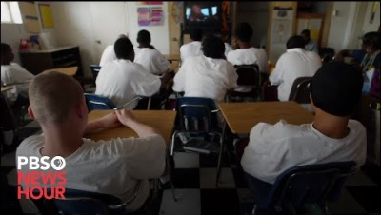
Prevention, Intervention, and Treatment of Juvenile Offending(6:25)

Slide 33
Prevention, Intervention, and Treatment of Juvenile Offending
Questions from the video (introspective)
Did they say these programs would work for all offenders?
Did they work with all age groups?
Did they address problems of social environment from which the offenders came?
  If the environment is a factor, what happens to a rehabilitated person thrown back into it?
They stated they selected the participants, did they indicate what criteria was used? Did they “cherry pick” only persons likely to succeed?

Slide 34
Prevention, Intervention, and Treatment of Juvenile Offending
Treatment and rehabilitation strategies
  Mental health diagnoses
    Focus on the individual
  Substance abuse disorders
    Focus on the individual
  Few programs are effective regardless of how intensive they are
    Why? Look at the above. Do they focus on the environment?

Slide 35
Prevention, Intervention, and Treatment of Juvenile Offending
  Many juvenile offenders are not motivated to change
    May like their deviant peers
      May also be all they have as friends
  Many that are referred are only referred after 3 or 4 appearances in court
    Treatment might their 4th or 5th chance
    Behavior well ingrained by this time
  How do you fix the neighborhood?
  How far are they behind in academics?
    Probably too far behind to catch up in a realistic period of time

Slide 36
Prevention, Intervention, and Treatment of Juvenile Offending
Characteristics of successful programs
  They begin early.
  They follow developmental principles.
  They focus on multiple settings and systems.
    Still only so much they can cover
  They acknowledge and respect cultural backgrounds.
  They focus on the family first.
    Really cannot focus on fixing the neighborhood, the school, crime rate etc.
  Have a lot of sessions/interactions
  Expensive and can only serve a limited clientele
  While more successful, how much more is debated

Slide 37
Prevention, Intervention, and Treatment of Juvenile Offending
Classification of prevention and treatment programs
  Primary prevention
    a. Deal with overall community risks
  Selective prevention
    b. Deal with specific individuals
  Treatment or intervention
    c. After a conviction

Slide 38
Prevention, Intervention, and Treatment of Juvenile Offending
Primary prevention
  Looks are reducing risk factors for all children in risk areas during their formative years
    Poverty is a risk factor
    High crime neighborhood
    Rejection by peers
    History of abuse
    Loss of a parent
      How would you fix those on a broad base?

Slide 39
Prevention, Intervention, and Treatment of Juvenile Offending
  Also, looks at increasing protective factors
    Improving parenting skills so parents show that they care
    Eliminating illicit drug use
    School or preschool performance
      May result in change of peers
  Development of resilience
Things found not to be protective factors:
  Religiosity
  Connected to school beyond school performance (just hanging out)

Slide 40
Prevention, Intervention, and Treatment of Juvenile Offending
Selective prevention
  Secondary prevention
  Targets specific children and adolescents who are at high risk.
  Early detection and early intervention will prevent more serious, habitual offending.

Slide 41
Prevention, Intervention, and Treatment of Juvenile Offending
Prevention in general
  Aim at more than one risk factor.
  Implemented before adolescence
  Fast Track
  As a group, these programs do not reduce recidivism

Slide 42
Prevention, Intervention, and Treatment of Juvenile Offending
Treatment approaches
  Self-regulation skills
  Improving cognitions
  Individual psychotherapy has not been effective when used in isolation
  Inclusion of family, school, peers, and community
    Since problems in any one of these by themselves could lead to delinquency
      Getting rid of one problem and leaving the other intact not likely to work

Slide 43
Prevention, Intervention, and Treatment of Juvenile Offending
Treatment approaches
  Residential treatment and incarceration are expensive and are not effective for serious offenders
    Studies have even shown that these methods may actually increase recidivism
      Who do they have as peers when in these facilities?
  Family approach must give families the resources they need
    Could be very costly

Slide 44
Prevention, Intervention, and Treatment of Juvenile Offending
Treatment approaches
  Change to more socially acceptable peers
    But what if the peers don’t accept them?
      Just because the delinquent’s attitude toward others’ changes does not mean that the other’s attitudes will change toward them
    Educational performance has been linked to the types of peers a person will have
      Can a short-term treatment program significantly improve this?

Slide 45
Prevention, Intervention, and Treatment of Juvenile Offending
Treatment approaches
  Many juveniles are sent to these programs only as “one last chance”
    These juveniles have a long history of antisocial behavior that will be difficult to fix
      Compare to personality disorders
  Some delinquency is linked to substance abuse
    In general, not a lot of success with these treatments

Slide 46
Prevention, Intervention, and Treatment of Juvenile Offending
Treatment approaches
  Expensive multi-systems treatment or functional family treatment have not been shown to be more effective than cheaper alternatives
    Baglivio suggests “if roughly twice as many youth may be served by the equally effective, cheaper alternatives, one would have trouble not pursuing those paths”
      One research caution. Just because a study shows that something is statistically significant does not mean that it is practically significant

Slide 47
Additional Resources
Videos:
Juvenile Delinquency: Two Types of Criminal Careers. (2018) Criminology Web. https://www.youtube.com/watch?v=D9RwqR7FIjc
What is a Status Offense? (2016) Vera Institute for Justice. https://www.youtube.com/watch?v=isuEPzqxZak
The Juvenile Justice System is Broken: Here is What Actually Works. (2021) PBS News Hour. https://www.youtube.com/watch?v=q1fsysGy_hM
FBI. Survivor of Juvenile Sex Trafficking Shares Her Story (2016) https://www.youtube.com/watch?v=mrgokIbGGNY
Text:
Office of the Attorney General (Virginia). Virginia Rules: Alcohol, Tobacco and Marijuana. (2023). https://virginiarules.org/varules_topics/alcohol-tobacco-and-marijuana/
Li, A. Patterson’s Coercion Theory and Coercive Cycle. Parenting for Brain. (2022). https://www.parentingforbrain.com/coercive-cycle/

